Slide 1

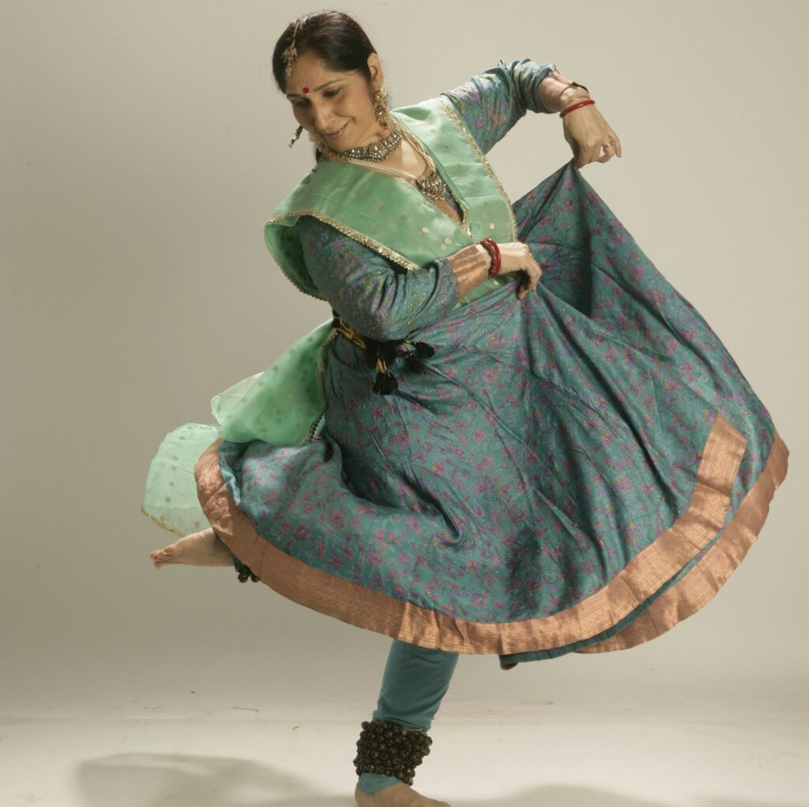
SPIC
MACAY
MUMBAI CHAPTER
IN ASSOCIATION WITH
KENDRIYA VIDYALAYA BHANDUP
PRESENTS
PTA. UMA DOGRA
- KATHAK
19th February 2017
8 - 9 AM
KV Bhandup, NCH Colony,
Kanjurmarg West, Mumbai
SPICMACAY is a voluntary, not for profit student movement.
We meet every Saturday, 4 pm at ICT, Matunga
Contact : Sabyasachi Dey (+918108098246)
Facebook : @SpicMacayMumbai

